Slide 1


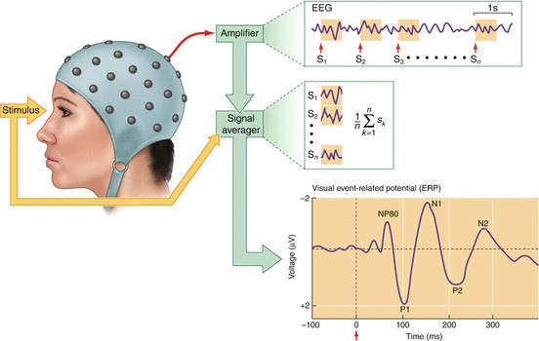
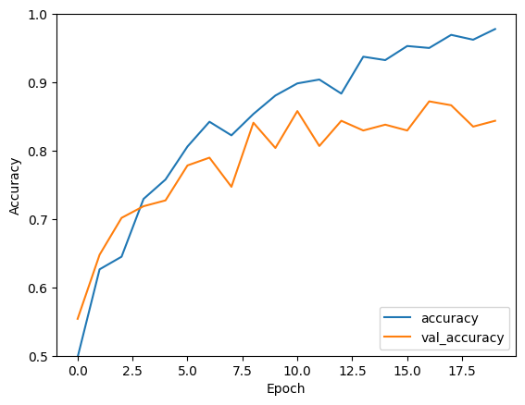
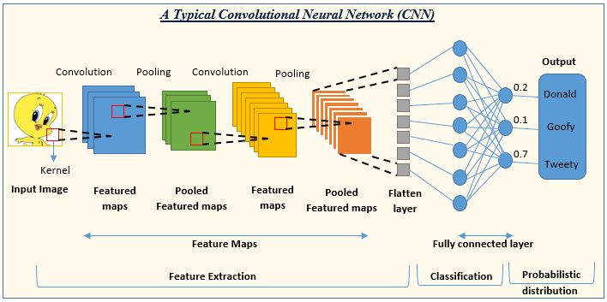
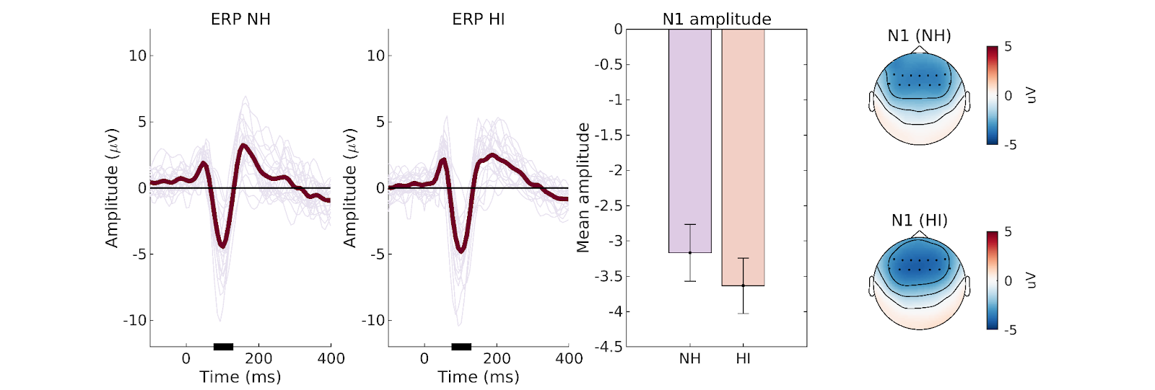
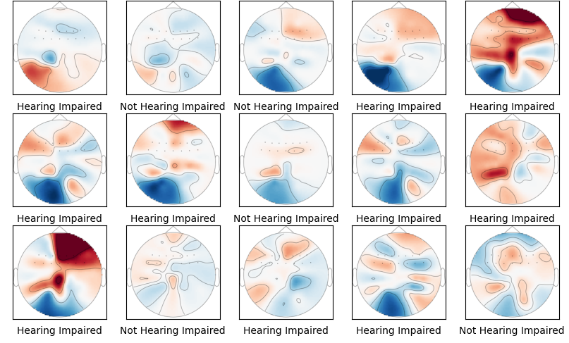
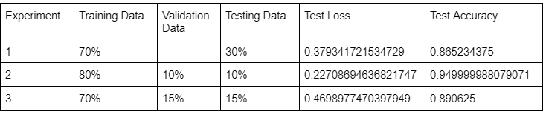


Scalp Maps for Hearing Impairment Detection: A CNN Model
Grace Wang, Dr. Beiyu Lin
University of Nevada, Las Vegas
Department of Electrical and Computer Engineering
Smart Cities REU: Summer 2023
Objective
Event Related Potentials (ERPS)
Discussion
The goal of this project is to utilize scalp maps derived from spatial and temporal electroencephalography (EEG) data to distinguish between individuals with hearing impairment and healthy individuals
Add your information, graphs and images to this section.
ERPs serve as the features utilized for classifying the two groups.
Acquired ERP waveform up to 400 ms after onset of tone stimuli for each patient.
Topographical scalp maps were extracted at 10 ms intervals within the 0 to 400 ms time range
Total images: 1,760
Dataset
The dataset contains EEG data from:
22 healthy subjects
22 hearing impaired subjects
Experiment recorded each patient’s event related potentials (ERPs) in response to 1 kHz tone beeps presented at random intervals 180 times.
Fig 3. Example of how ERPs are extracted
Convolutional Neural Network (CNN) Architecture
CNN is effective in distinguishing the two group. Averaged accuracy is around 85%-90%
Conclusion
Ways to enhance the model's accuracy and generalization:
support vector machines (SVM)
random forests
recurrent neural networks (RNNs)
cross-validation
hyperparameter tuning
regularization
Fig 1. Individual traces of ERP data averaged over fronto-central electrode cluster Thin lines reflect data from individual subjects. Thick lines reflect group-mean averages.
Results
Fig 4. Results of applying CNN on different types of data splits
Acknowledgements
Dr. Joel Snyder, UNLV Psychology
Dr. Brendan Morris, UNLV Electrical and Computer Engineering
Dr. Sarah Harris, UNLV Electrical and Computer Engineering
Søren A. Fuglsang, Jonatan Märcher-Rørsted, Torsten Dau, & Jens Hjortkjær. (2020). Selective auditory attention in normal-hearing and hearing-impaired listeners [Data set]. Zenodo. https://doi.org/10.5281/zenodo.3618205
1950872
Fig 2. (left) Examples of hearing impaired and healthy scalp maps
(right) averaged scalp maps of hearing impaired and healthy group

